Slide 1
Computer Programming for the Liberal Arts- Introduction to Python Programming Language and Jupyter Notebook

Slide 2
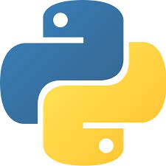
The Python Language
In the early 1990’s, Guido van Rossum designed what would become the Python programming language
He needed a language that could not only be used to create programs quickly but also make them easy to modify
It was designed to have a much simpler and cleaner syntax than other popular languages such as Java, C and C++ (making it easier to learn)
Python is interpreted, making it easier to develop and test short programs
Python programs are executed by the Python interpreter
The interpreter reads your program and executes it

Slide 3
Translating a program to machine language
Interpreter
Directly executes the instructions in the source programming language
Read one instruction → Execute it →Read next instruction →Execute ....
Example: Python
Compiler
Translates all the instructions into machine code at a time and then, execute
Read all the instructions →Execute it
Example: Java, C++

Slide 4


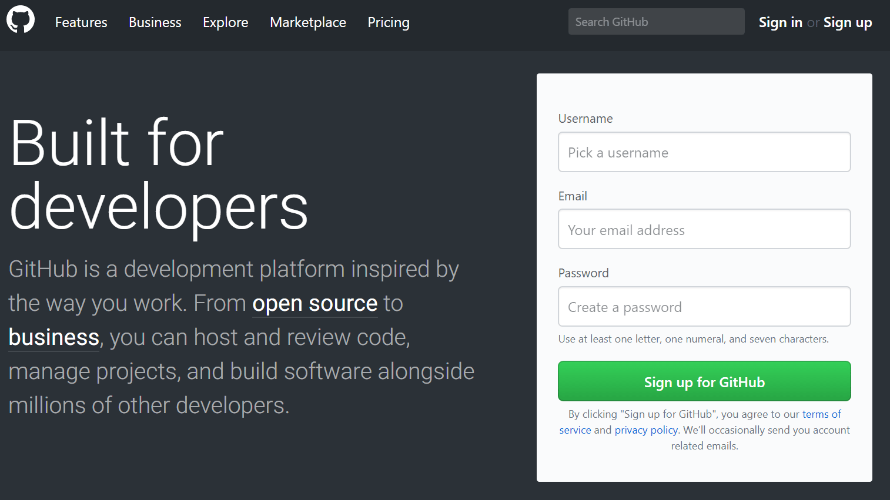
Course Materials
Textbook: Python Crash Course, 2nd Edition: A Hands-On, Project-Based Introduction to Programming
Anaconda Python (https://www.anaconda.com/products/individual)
GitHub Account (https://github.com)

Slide 5
Learning Outcome
Choose the correct programing structures to use for various problems and data structures
Use Jupyter Notebooks to write interactive Python programs
Maintain a code repository for sharing code

Slide 6

Jupyter Notebook in Anaconda Python
The Jupyter Notebook interface is a Web-based application for authoring documents that combine live-code with narrative text, equations and visualizations
Spyder: Scientific Python Development Environment, is a free integrated development environment (IDE) that is included with Anaconda. It includes editing, interactive testing, debugging, and introspection features.

Slide 7
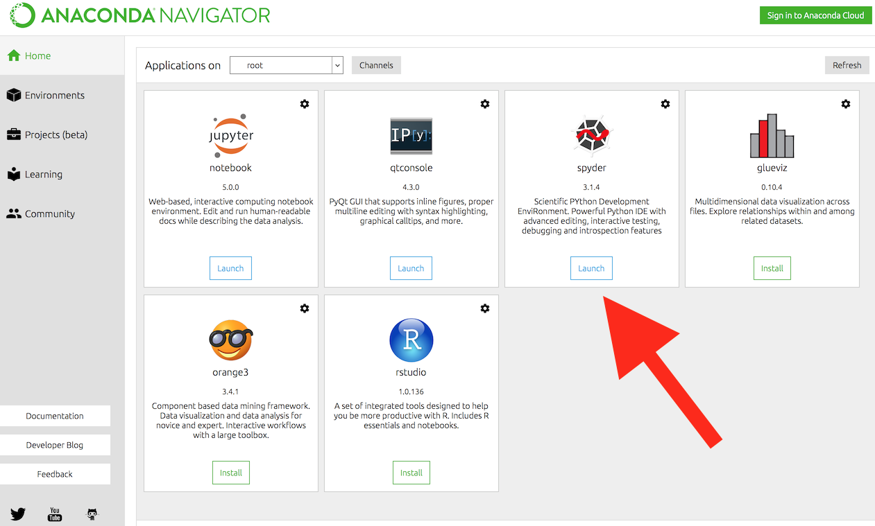
Downloading Anaconda
Visit https://www.anaconda.com/products/individual
Select suitable operating system (Windows/MacOS/Linux) where the three operating systems are listed
Download ...
Open and run the installer ...
Open the Anaconda Prompt from the start menu:
Windows: Click Start, search Anaconda Prompt from the menu.
MacOS: Cmd+Space to open Spotlight Search and
type “Navigator” to open the program.
Linux: Open Applications - System Tools - terminal.
Terminal – type python --version

Slide 8
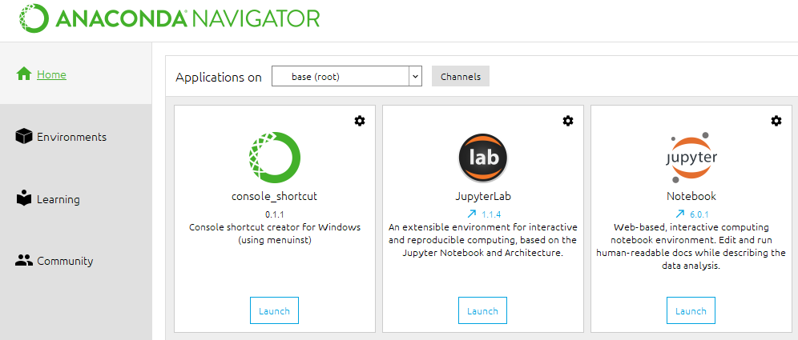
Work with Jupyter Notebook
A notebook integrates code and its output into a single document that combines visualizations, narrative text, mathematical equations, and other rich media.
In other words: it's a single document where you can run code, display the output, add explanations, formulas, charts, and make your work more transparent, understandable, repeatable, and shareable
Terminal – type Jupyter Notebook
Cells: Code and Markdown

Slide 9
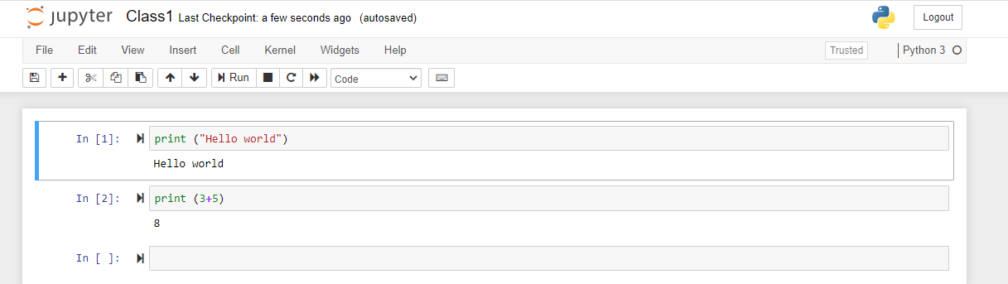
Your first program-Jupyter Notebook
Traditional ‘Hello World’ program in Python
We will examine this program in the next section
Typing the program into your IDE would be good practice!
Be careful of spelling e.g., ‘print’ vs. ‘primt’
Python is case sensitive.

Slide 10
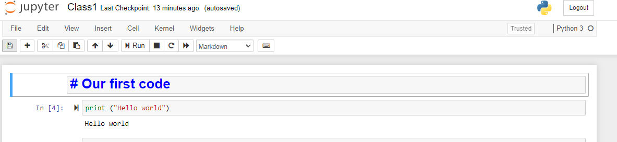
Using Markdown in Jupyter Notebook
Markdown is a human readable syntax (also referred to as a markup language) for formatting text documents.
Markdown can be used to produce nicely formatted documents including PDFs and web pages.

Slide 11
Some Markdown Syntax supported by Jupyter NB
Heading:
# (Header 1, title)
## (Header 2, major headings)
### (Header 3, subheadings)
#### (Header 4) up to 6
Blockquotes: can hold the large chunk of text and are generally indented
>This is a good day
Lists:
* This is a bullet list
1. ordered lists
2. using numbers
Bold and italics:
**These are bold words**
*These are italicized words*
Highlight code: backtick
`Here is a code for printing statements!`
Hyperlinks:
`Github` can be found at
<a href="https://github.com/login?">this link</a>
The href attribute specifies the URL of the page the link goes to.
Render image:
![Python Logo](https://www.python.org/static/community_logos/python-logo-master-v3-TM.png)

Slide 12
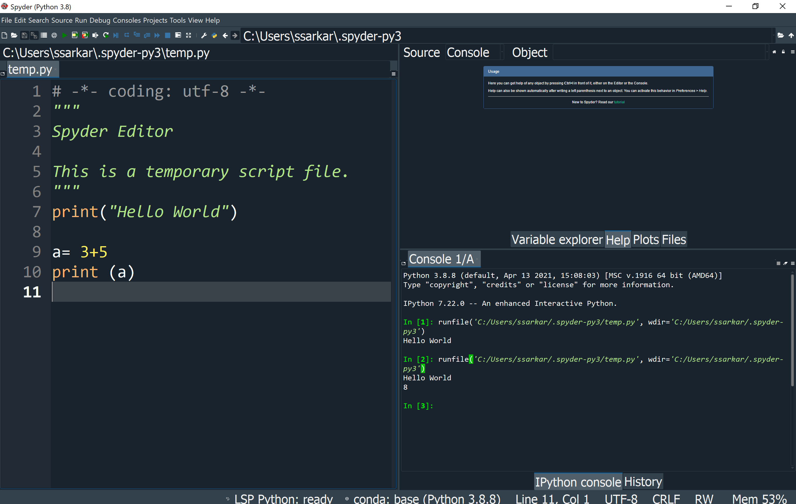
Your first program-Spyder
Spyder: .py is a regular python file. It's plain text and contains just your code.
Jupyter Notebook: .ipynb is a python notebook and it contains the notebook code, the execution results and other internal settings in a specific format. You can just run .ipynb on the jupyter environment.

Slide 13
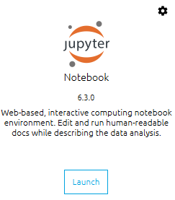
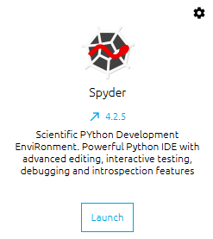
Jupyter Notebook vs Spyder
Jupyter is an interactive Python notebook where you can run code, visualize data and include text all in one document, while Spyder is an IDE specifically for scientific programming in Python.
Jupyter Notebook:
It is a web application to edit and share code
Good to show visualizations.
Its not good for projects with large code because of no in-built debugger
Especially useful when you quickly want to try simple code or which has run time for seconds
Consider Jupyter if you work on data-driven projects where you need to easily present data to a non-technical audience.
Spyder:
Its an IDE developed for scientific programming written in Python for Python. It mainly comes with
Editor
IPython console
Variable explorer
Debugger
Features like Syntax highlighting and better Graphical User Interface (GUI) are especially useful to work on projects with large code.
Consider Spyder for building data science applications with multiple scripts that reference each other.

Slide 14
GitHub
A software repository/version control system for pushing code to an online code repository
Repository (allows your work to get out there in front of the public)
Easier in documentation
It makes it easy to contribute to your open-source projects
Most companies look into the GitHub profiles*
*Depending on what you end up doing after graduation

Slide 15
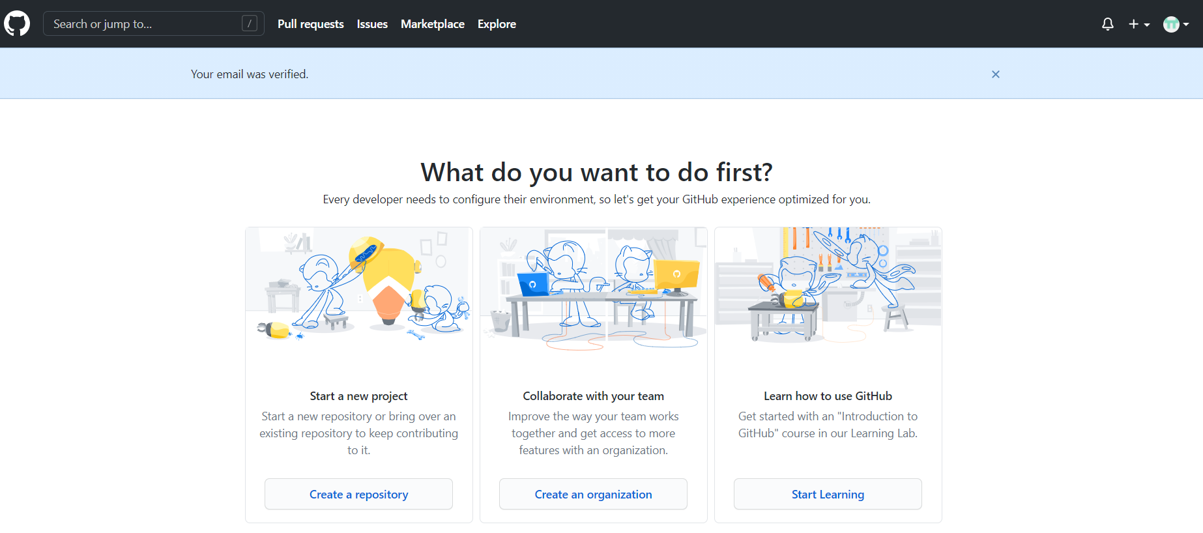
Work with Github
Create a profile at Github
https://github.com/signup?ref_cta=Sign+up&ref_loc=header+logged+out&ref_page=%2F&source=header-home

Slide 16
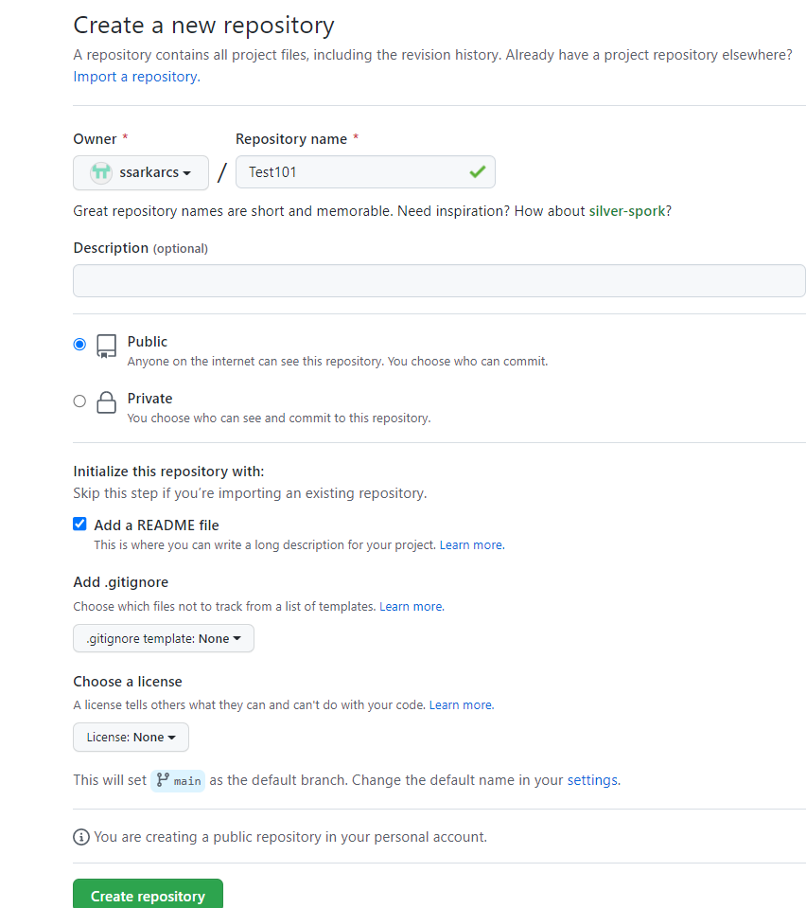
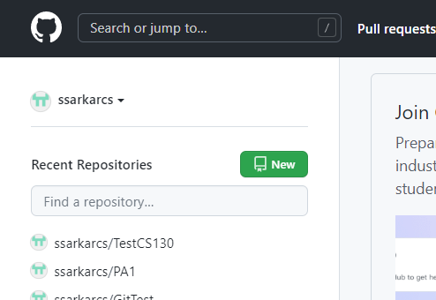
How to create a new Repository

Slide 17
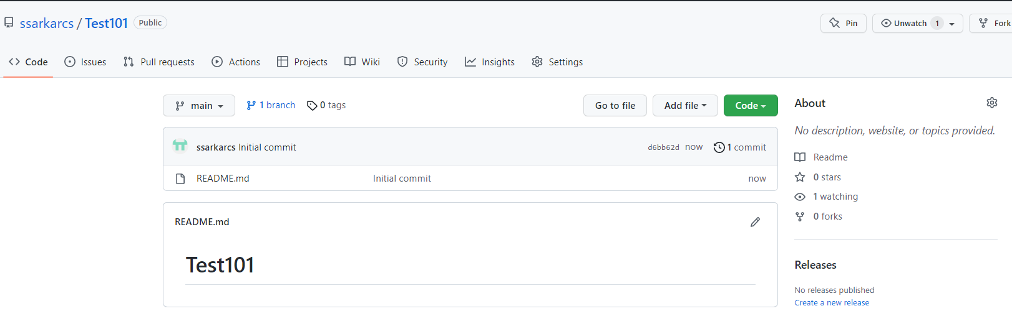
The new Repository

Slide 18
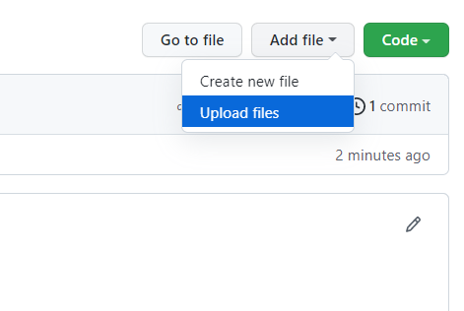
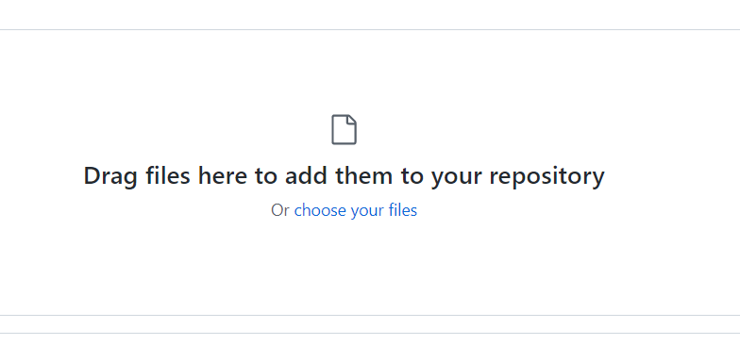
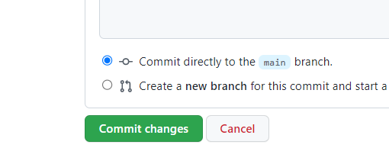
Adding files into new Repository

Slide 19

How to submit on Moodle
https://github.com/ssarkarcs/Test101
Submit this link on Moodle at assignment submission portal

